Slide 1

Session #H: Naming Things Peter Ritchie

Slide 2
Three Hard Problems in Software Engineering – The Saying
Naming
Off-by-one errors
Notes:
Originally cache validation and naming things by Phil Karlton. But I couldn’t resist two jokes in one.

Slide 3

About me
30+ years’ experience helping enterprises optimize delivery of software systems.
Passionate about patterns and practices and sharing knowledge with software development communities.
Influencer, author, and blogger
Microsoft Most Valuable Professional 2007-2019
Microsoft Certified Professional
Certified SOA Analyst
Certified SAFe Architect.
Peter Ritchie
Principal Platform Consultant, Products and Platforms Engineering Services

Slide 4
Agenda
1
Things we Name
Naming Things
2
Things that make it hard
3
Things to consider
4
Tips
5
Questions

Slide 5
Naming Things
Have You Ever?
public class DataManager
public bool Complete { get; set; }
namespace Console

Slide 6
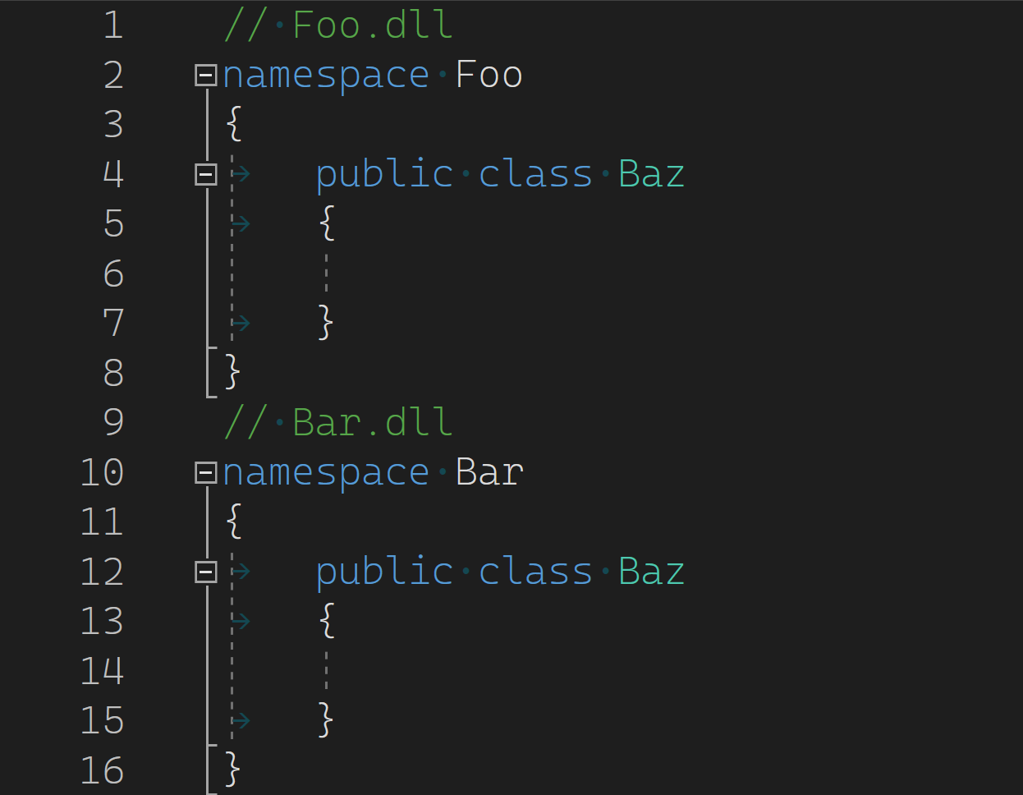
Naming Things
What’s the big deal?
public class DataManager
public bool Complete { get; set; }
namespace Console

Slide 7
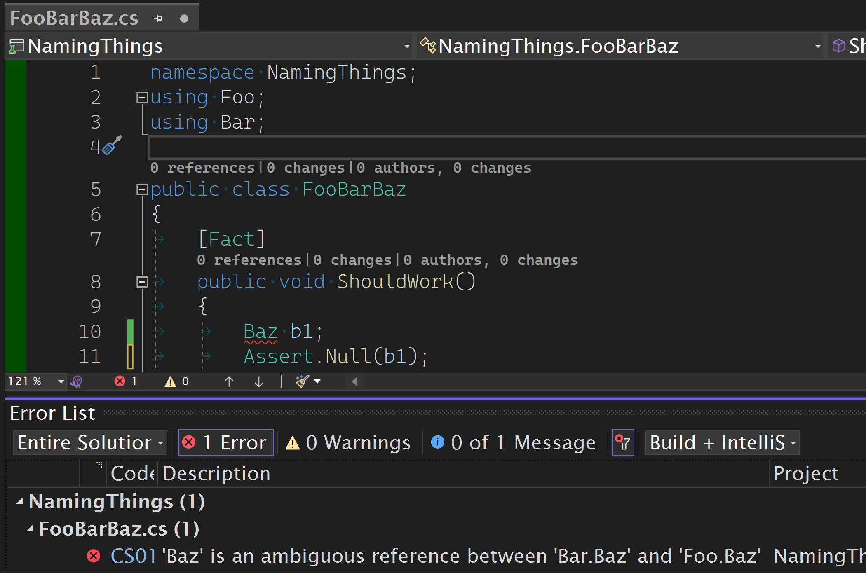
Naming Things
Deep changes necessary
public class DataManager
public bool Complete { get; set; }
namespace Console

Slide 8
How Did I Get Here?

Slide 9
Existing Guidelines: .NET
DO name classes and structs with nouns or noun phrases
...methods, which are named with verb phrases.
DO name interfaces with adjective phrases, or occasionally with nouns or noun phrases.

Slide 10
Existing Guidelines: Java
Methods should be verbs.
Class names should be nouns.
Notes:
The problem with saying just “verb” or “nouns” is

Slide 11
Oh, Okay; Now it’s Clear.
Verbs:
Be
Seem
Were
Nouns:
Green
Warmth
Collections

Slide 12
https://github.com/ peteraritchie/NamingThings
Notes:
I’ve since found other references that I keep track of on my repo.
So far that covers classes, structs, methods, and sometimes interfaces?

Slide 13
Other Things We Name (Scoped to This Session)
Abstract classes
Namespaces
Class libraries
Application
Service
Capabilities
Properties
Hierarchies
Sub-namespaces
Inline classes
Notes:
All these things interact and collaborate, introducing naming opportunities.

Slide 14
Factors
Business
Conceptual
Entities
Services
Processes
Functions
Deliverables
Hierarchy
Layers
Project
Processes
Notes:
It’s important to take into account various factors when naming things

Slide 15

Contributors to Difficulty
The Usual Culprits
Notes:
“Problem”

Slide 16
Computer Language Constraints
Naming clashes
Type names
Namespaces
Members
Deployment-specific components
Modules/Libraries
Packages

Slide 17
English

Slide 18
English is Tricky
The bandage was wound around the wound.
The farm was used to produce produce.
The dump was so full that it had to refuse more refuse.
We must polish the polish furniture.
He could lead if he would get the lead out.

Slide 19
English Constraints
Understandability
Implicit Meanings
Word classes
Parts of speech
Derivational conventions

Slide 20
Requirements

Slide 21
Lack of Business Clarity
Lack of intent or purpose
Lack of domain boundaries
Conflating outcome and output
Lack of clarity of input
Business process vs rule
Business Step vs Activity
Notes:
AKA lack of leadership

Slide 22
Tips
Notes:
Some things I’ve noted or collected while coming up with this talk. These are tips, I won’t be offended if you disagree

Slide 23
Tips - General
Consistency
You can avoid clashes if things are named consistently
Don’t be Arbitrary
Group things together with purpose so that a name is apparent
Don’t try to pre-define all possible scenarios
Understanding known terminologies is essential, but don’t guess at the unknown
Be as explicit as possible, avoid ambiguity
Rely on the Business and requirements for meaning
If the requirements aren’t clear, you naming will be unclear too

Slide 24
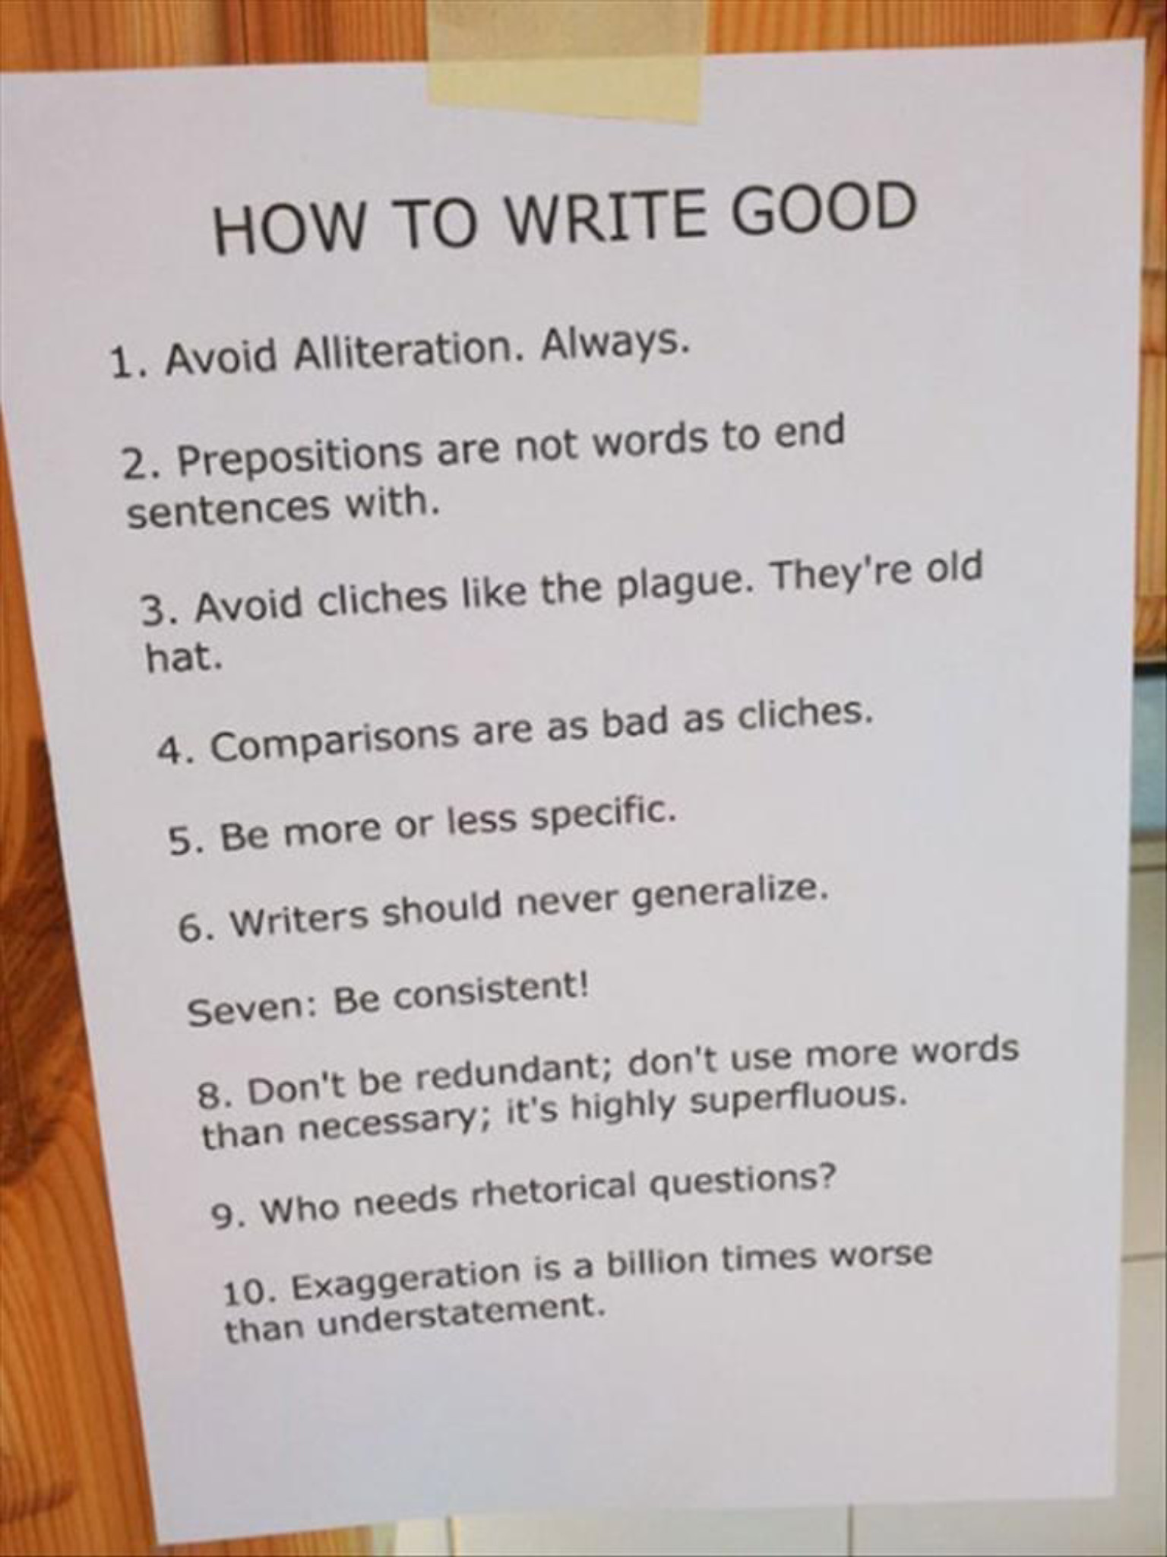

Slide 26
Tips – Use Adjectives for Namespaces
namespace MyCo.MyProduct.Mathematics
{
public static class Mathematics
{
public static T Add<T>(T left, T right)
{
//...
throw new NotImplementedException();
}
}
// ...
}

Slide 27
Tips – Use Adjectives for Namespaces
namespace MyCo.MyProduct.Mathematics
{
public static class Mathematics
{
public static T Add<T>(T left, T right)
{
//...
throw new NotImplementedException();
}
}
// ...
}

Slide 28
Tips – Use Adjectives for Namespaces
namespace MyCo.MyProduct.Mathematical
{
public static class Mathematics
{
public static T Add<T>(T left, T right)
{
//...
throw new NotImplementedException();
}
}
// ...
}

Slide 29
Tips – Use Adjectives for Namespaces
namespace MyCo.MyProduct.Mathematical
{
public static class Mathematics
{
public static T Add<T>(T left, T right)
{
//...
throw new NotImplementedException();
}
}
// ...
}

Slide 30
Tip – Use Plural for Namespaces
namespace System.Collections
{
public class ArrayList;
public class Queue;
public class SortedList;
public class Stack;
}
Notes:
AKA countable nouns

Slide 31
Tips – Namespaces
Adjective namespaces for types related to a theme or features
Plural namespaces for types implementing the same interface

Slide 32
Tips – Agreement on Common Outcomes
Created signifies something new has come into existence (rather than Added).
Added signifies something has been added to a container or collection.
Updated signifies the value properties or attributes of an existing thing (entity) have been changed.
Changed signifies an entire thing (entity) has been replaced with another.

Slide 33
Tips – Agreement on Common Outcomes
Deleted means something is no longer accessible in some context.
Destroyed means removed from existence, no possible way to ever get it back.
Removed means the opposite of Added, a thing has been moved out of or removed from a container/collection
Modified means structure or schema has changed and isn't related to instantiated entities.

Slide 34
Tips – Classes
Name classes as a Noun or Noun Phrase
Use action nouns; classes should do things
Green is a noun, but not good as a class name.
Noun Phrase:
<adjective><noun>
Notes:
The class name should make it clear what the class does.
Avoid abstract names

Slide 35
Tips – Interfaces
Name interfaces as adjectives
Adjectives formed from verbs: interfaces imply an ability to do something
E.g.
IEnumerable
ITransmissive
Hint adjective suffixes: -ive, -able, -er, -or
Notes:
This can be difficult. Adj

Slide 36
Tips – Prefixes
Agree on elemental types and be consistent about prefixes
Date & Time : …DateTime
Date: …Date
Identifiers: …Identifier
Text: …Name, …Description, …DisplayText
Percentages: …Ratio
Interest Rates: …Rate
Monetary Values: …Amount, …Payment
Notes:
I don’t want to deviate too much into conventions, but I find domains have elemental types and getting agreement on terminology and meaning to go a long way to consistency and understanding.

Slide 37
Tips – English
Warning: Grammar Ahead

Slide 38
Tips – English
Avoid ambiguity
Avoid zero-derivation words
Fish: singular
Fish: plural
Avoid metonyms and nounification
Metonym: “Washington” means “federal government”
Nounification: “ask” means “question”
Avoid homographs (and homonyms)
Notes:
Green is a noun, but as a class name it doesn’t tell you what it does.

Slide 39
English is Tricky
The bandage was wound around the wound.
The farm was used to produce produce.
The dump was so full that it had to refuse more refuse.
We must polish the polish furniture.
He could lead if he would get the lead out.

Slide 40
Tips – Getting Clarity from the Business

Slide 41
Tips - Make the implicit explicit
E.g., Vision:
There is too much suffering from cancer.
Better
We see a world with better cancer prevention and treatment.

Slide 42
Tips – Cascading Business Motivation
A PC on every Desk
Affordable Software
Student Pricing
#1 Spreadsheet
Vision
Priorities
Strategic Objectives
User friendly Software
Notes:
Understand the lineage of the objectives, the priorities driving them and the vision driving it all.

Slide 43
Tips – Cascading Project Motivation
Contribute to every mortgage transaction
Zero learning curve
Standards-based
Support realistic interactions
Vision
Priorities
Strategic Objectives
Flexible

Slide 44
Tips – OKRs
Support realistic interactions
Support 90% of MISMO Life of Loan Application Process
Objective
Key Results
100% Alignment with URLA Data Elements

Slide 45
Tips – Business Clarity
Make sure the work aligns with the business motivation and priorities
This focuses the work, makes it less arbirary and open to consistency
Structure the motivation of the work
Include project and or component visions and missions
Organize features and stories by different motivations

Slide 46
Tips – Inspiring Methodologies

Slide 47
Tips – Methodologies and Practices
Domain Driven-Design
The language of the business: Ubiquitous Language
Event Storming, Event Modeling
Collaborative exploration of the domain for process alignment
Clearn understanding of inputs, events, processes, and outputs

Slide 48
Domain-Driven Design
Ubiquitous Language, Domain-specific outcomes:
Locked As in Interest Rate _Locked.
Moved As Client Moved to a different address.
Sent As in Underwriting Request Sent.
Corrected As in Client Name Corrected.
Began As in Loan Processing Began.
Completed As in Underwriting Completed.
Rejected As in Application Rejected.
Notes:
Try to get this stuff out of the way or understood before undertaking major coding

Slide 49
Domain-Driven Design, Event Modeling, Event Storming
Contexts
Policies
Rules
Events
Attributes
Commands
Actions
Processes
Flows
Sequences
Actors
Responsibilities
External Sysems

Slide 50
Thank you

Slide 51

Let’s keep the conversation going!
www.accenture.com/PPES
Peter.Ritchie@outlook.com
@PeterRitchie
Visit our booth (look for the button maker & blue balloons)
And don’t forget to connect:
/in/peteraritchie
/peteraritchie
Notes:
Product and Platform Engineering Services

